Slide 1
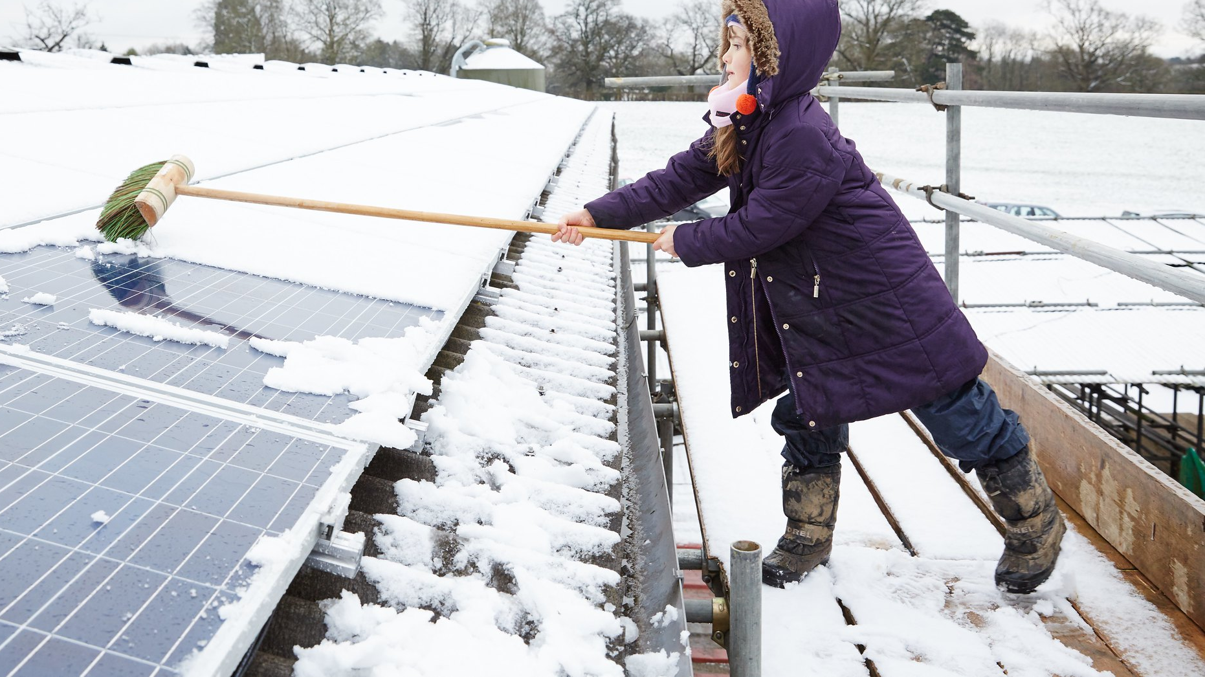
Community energy in Calne
Sophy Fearnley-Whittingstall

Slide 2
Setting up a Community Solar Farm
Renewable energy asset where the community has invested and profits go back to local community
Develop
Construct
Own & operate
Bring operational solar farm into community ownership
Shared ownership with commercial developer

Slide 3
What do you need for a solar farm?
Access to grid connection
Well screened
Free from planning restrictions e.g. AONB
Support from local community
25 acres = 5 MW
Enough for 1500 homes
Saves approx. 2,000 tonnes CO2

Slide 4
Grid Capacity in Calne Area
Distribution Network Operator (DNO)
Scottish and Southern Electricity (SSE)
Calne area is constrained

Slide 5
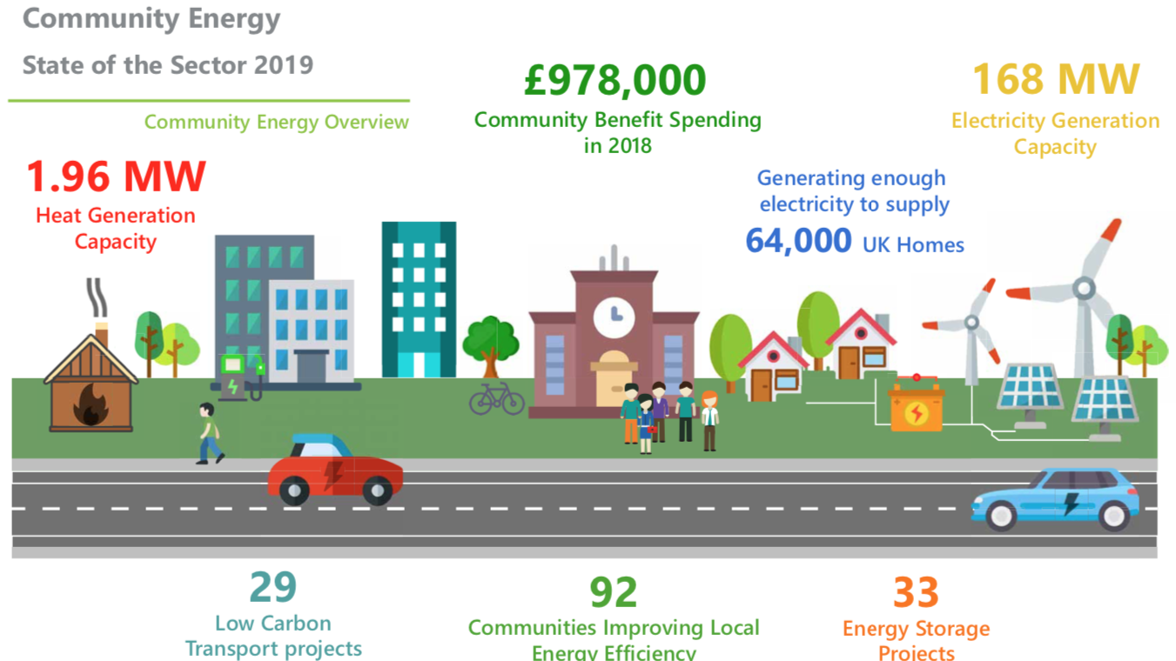

Slide 7
Other models of community energy
Zero Chippenham
Community solar PV buying scheme.
Calne residents are eligible to join
Recommended installers
Up to 20% discounts

Slide 8
Other models of community energy
Rooftop solar on community buildings, e.g. Salisbury Community Energy/Schools Energy Co-op
Rooftop solar on social housing, e.g. Lockleaze Loves Solar
Electric Vehicle car clubs, e.g. Nadder Community Energy
Tackling fuel poverty through energy efficiency advice, e.g. Climate Friendly Bradford-on-Avon

