Slide 1
Welcome to
Calne Community Area
Fairtrade Group
Friday 23rd February 2018 4pm
Calne Baptist Church

Slide 2
Business from last meeting
Minutes
Matters Arising
FTF Town Hall Event
Second part of the Meeting
FTT Action Plan Updates & Actions
Fairtrade Fortnight Planning

Slide 3
Matters Arising
Audits
Campaign Advertising
Banners
Posters
Roundals
Sainsburys

Slide 4
Matters Arising
Coop Food = Yes - plus store display
Sainsburys = Yes
Tesco = Don’t know
Calne Choral = Yes
Calne Players= Yes (subject to scripts)
Schools = no results on Art Exhibition
Schools – One wants a FT assembly in FTF

Slide 5
Town Hall Programme
The Programme - 8.30am Setup
Tables and stage will be in place for us
PA system & Projector & programme on laptop
Bunting & Balloons
Stall & Campaign Posters on walls
Setup stalls – stall holders (bring colourful table coverings)
Raffle & Raffle table – location & timing!!

Slide 6
Town Hall Programme
The Programme
8.30am Setup – Please be on time
10.00am - Event Opens - with Fairtrade STALLS throughout the event 10.30am - The Calne Players - a Short Fairtrade Story 10.50am - The Mayor Cllr. Tony Trotman welcomes Mr Baai Jarbang 11.00am - Mr Baai Jarbang "The mango industry and its potential in The Gambia" 11.30am - (timing subject to Mr Baai Jarbang's speech and questions) Light lunch follows our guest speaker with choral accompaniment from: "7CC + 1" ("Eight members of Calne Choral sing a Cappella"). 12.15 – Raffle Draw (approx time)
1.00pm - Event Closes (clear up)
2pm - leave

Slide 7
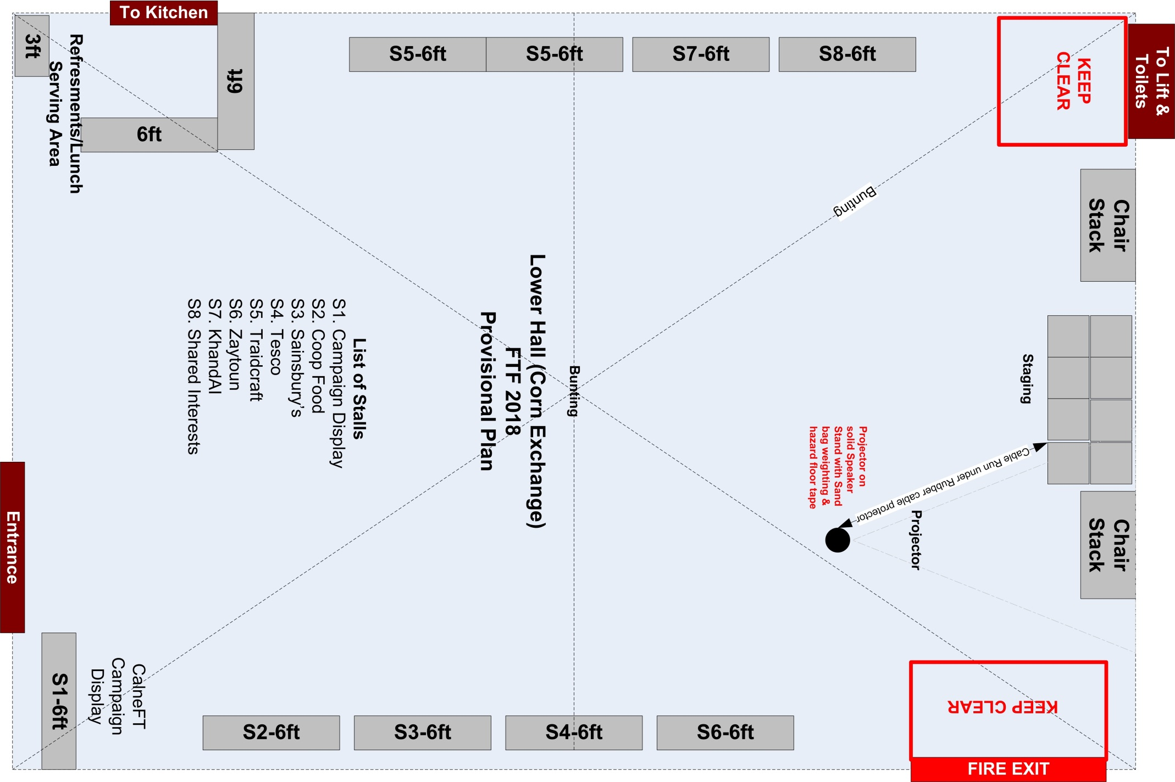

Slide 8
Town Hall Food
Tea and Coffee?
Light Lunch
Bread &

Slide 9
Dates of Next Meetings
Next Meeting?
Always schedule two meetings ahead

