Slide 1
Welcome to
Calne Community Area
Fairtrade Group
Thursday 20th September 2018 4pm
Calne Baptist Church

Slide 2
Business from last meeting
Minutes
Matters Arising
Second part of the Meeting
FTT Action Plan Updates & Actions
Fairtrade Fortnight Planning

Slide 3
Matters Arising
AGM 2018/19
“A Gambian Experience”
Audits
Derry Hill – Christ Church
Butfield Breach
Sainsbury – HUB FT tea & Coffee

Slide 4
Campaign Update
Town Churches – All except Free Church and Zion!
Baptist, Methodist, Evangelical, St Mary’s, St Edmunds, Holy Trinity, St Peter’s – plus Dayspring (Derry Hill), St Laurance (Hilmarton)
Town Retail Stores
Tesco, Tesco Express, Sainsbury, Coop, , New Wine Shopp, Giftbox, Esso Spar, Flying Pig, Martins, Upper Crust.
Below threshhold: Iceland, Laundramagic, Sampaguita.
B&B/Hotels
Landsdowne and Heritage B&B
FT Involvement
Hilmarton School, JBS, St Margarets, St Mary’s, Guides
AIM: Apply November 2018

Slide 5
Fairtrade Town Application
Early November 2018
Plan?
Award in time for Fairtrade Fortnight 2019
Comments?

Slide 6
Budget & Finance
Accounts
Calne Area Board Award (LYN) for
“A Gambian Experience”
£2,433.27 of a total budget of £4,211.09
Grant provisional upon getting young people involved.
Eight Students from JBS involved.

Slide 7
“A Gambian Experience”
Two Public Events
Thursday 11th - Saturday Morning 13th October
An Exhibition of Photography
“Images of “Stories of Lives Lived”
Saturday Evening 13th October 7pm
A Live Event – “Stories of Lives Lived”
Music by Live Gambian Drummers

Slide 8
“A Gambian Experience”
A Private Launch Event – Invited Guests
Wednesday 10th October
“A Gambian Experience”
@ The Exhibition of Photography
“Images of “Stories of Lives Lived”
Refreshments

Slide 9
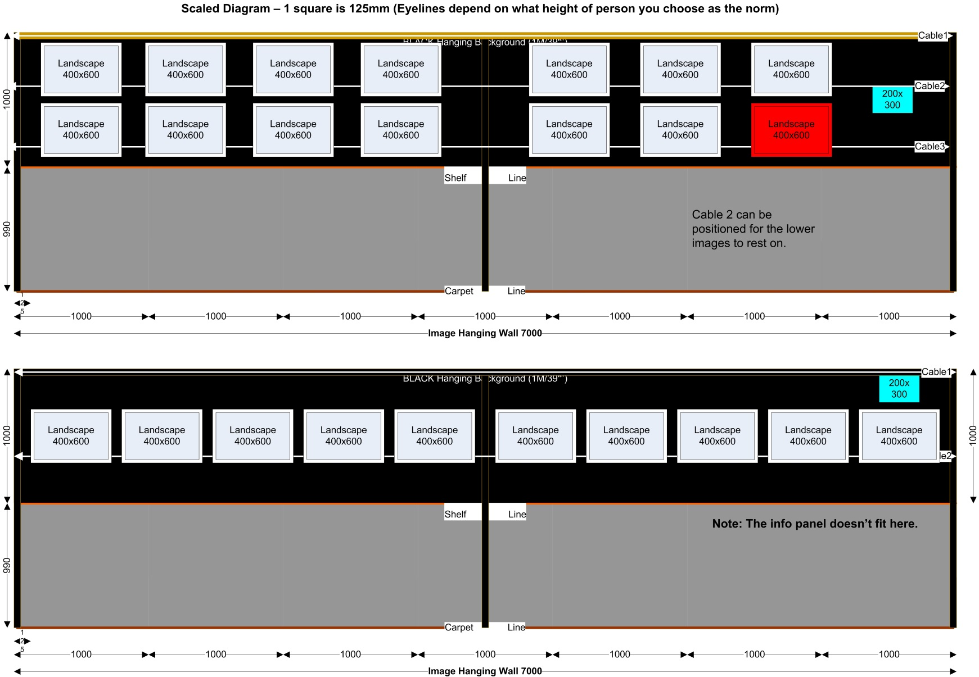
“A Gambian Experience”

Slide 10
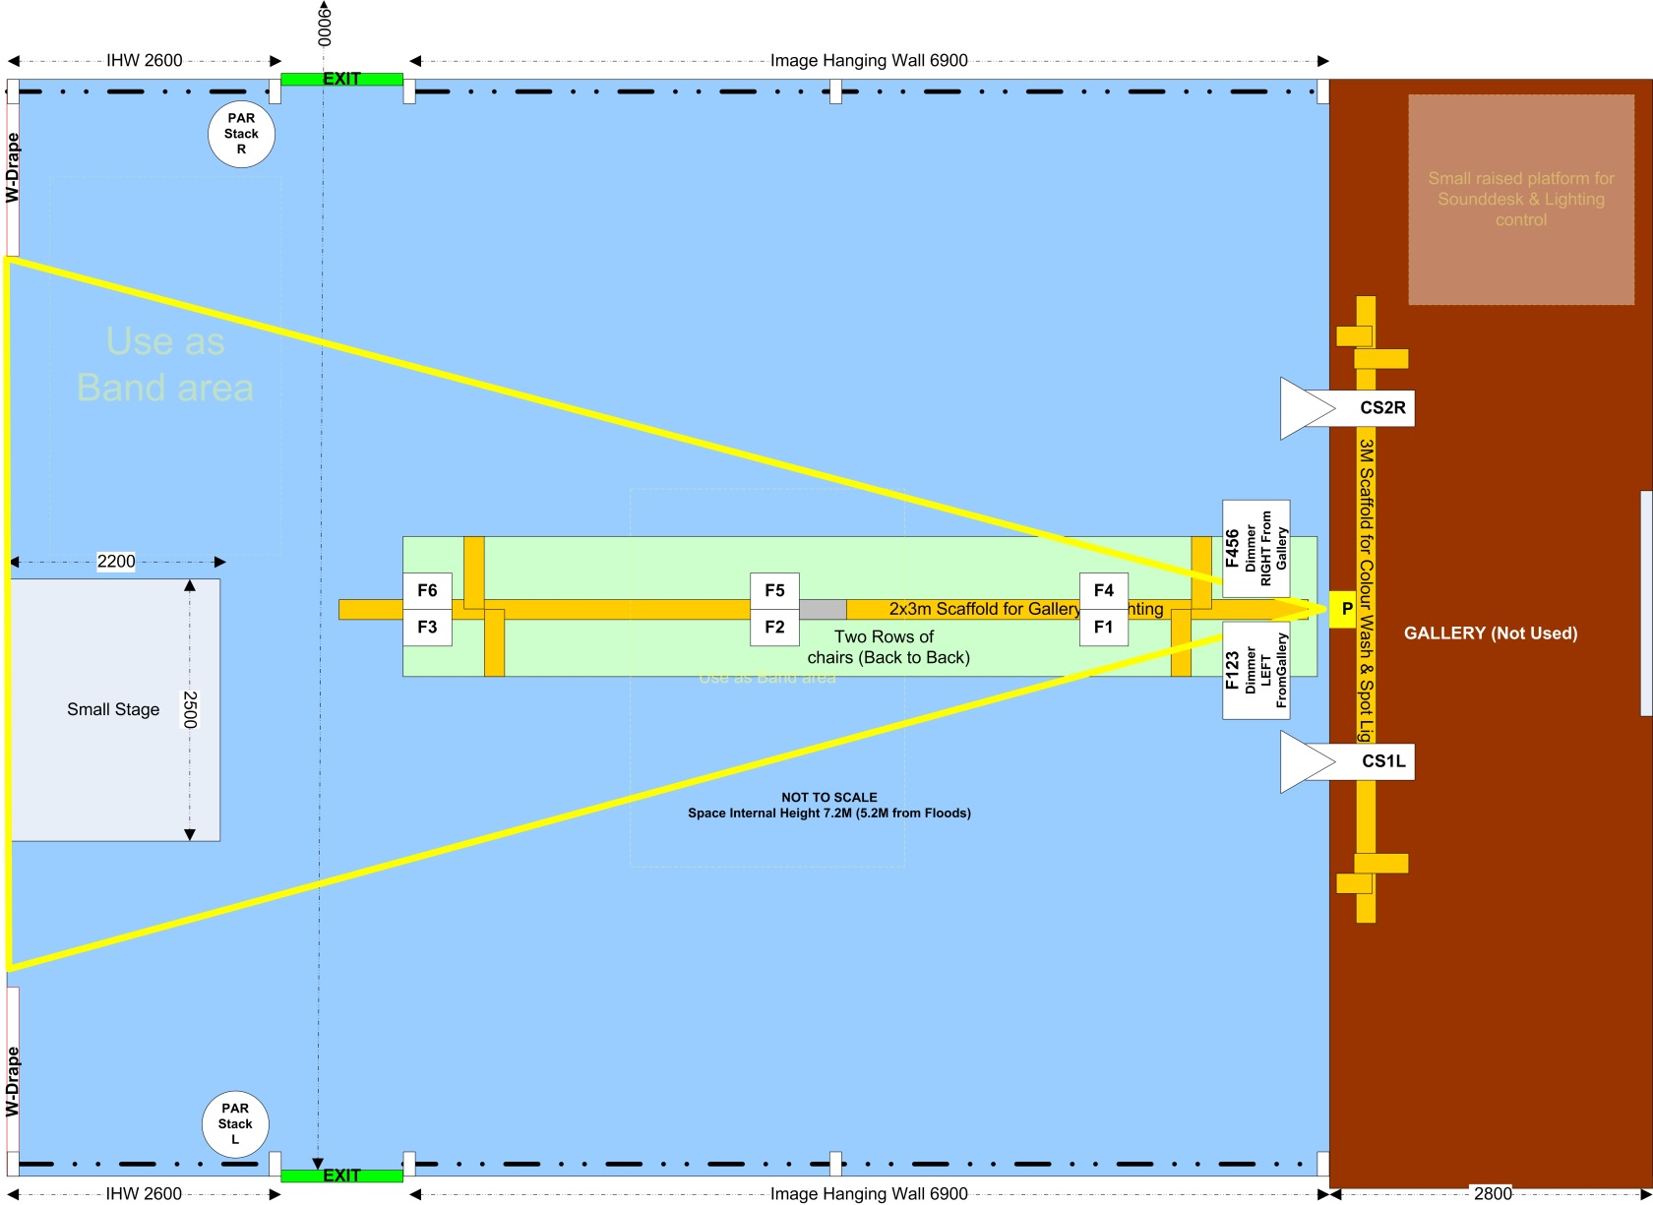
“A Gambian Experience”

Slide 11
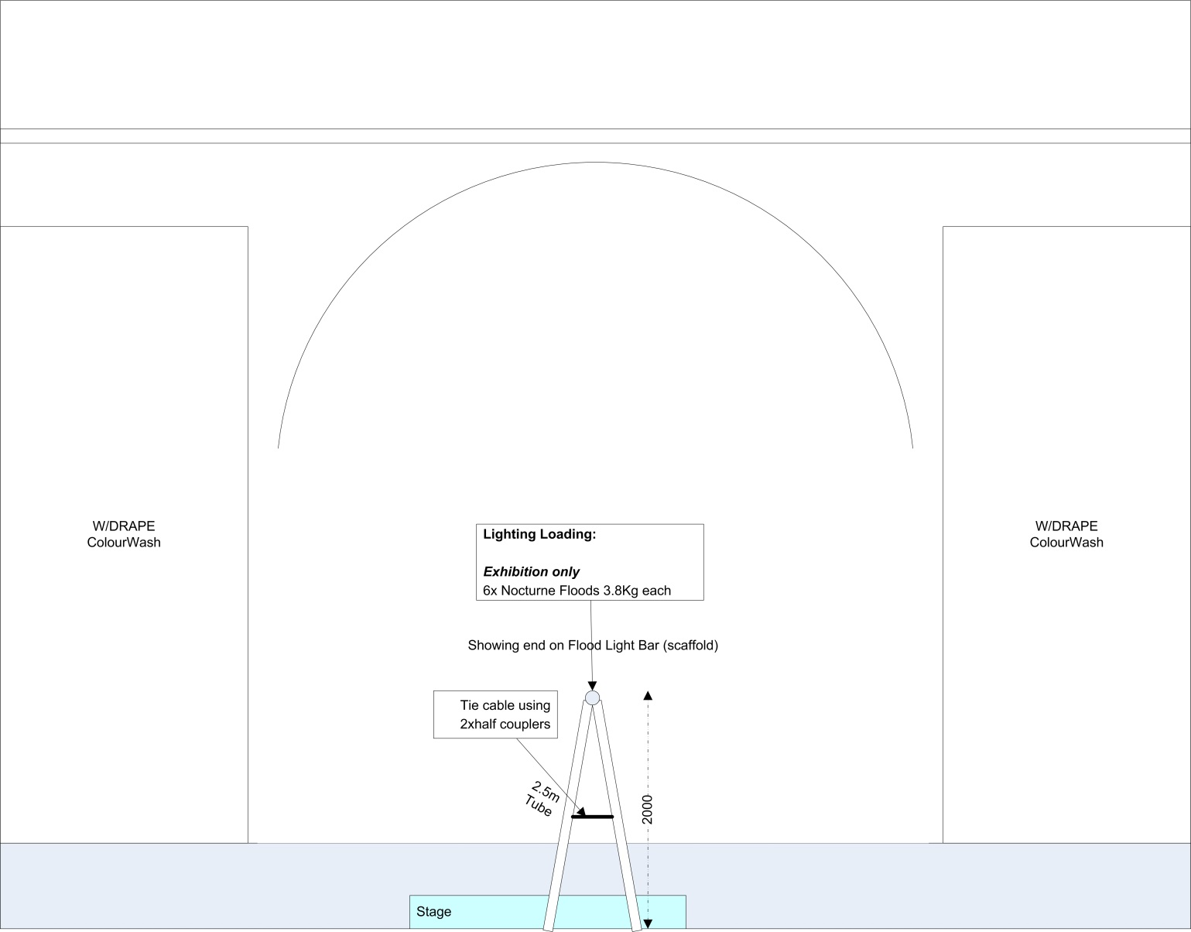
“A Gambian Experience”

Slide 12
“A Gambian Experience”
Help at the events…
Wed Evening…
welcome to guests, car park management, help with refreshments
Thur-Sat AM… (Exhibition)
welcome to public, showing people round, help with Tea & Coffee
Sat Evening… (Live Event)
Help setting up during the afternoon.
welcome to public, seating management (reservations), car park management, help with tea & coffee.

Slide 13
“A Gambian Experience”
See…
www.calnefairtrade.org.uk/age
www.cmaf.org.uk

Slide 14
Policy & Procedures
GDPR – see website
Equal Opportunities
Health & Safety
Safeguarding (Children and Vulnerable Adults)
DBS Status of Steering Committee

Slide 15
Dates of Next Meetings
Next Meeting?
Thursday 18th October at 4pm @JBS
Thursday December ?? @ ??

