Slide 1
Welcome to
Calne Community Area
Fairtrade Group
Annual General Meeting
Marden House Centre
Thursday 2nd May 2019 7pm

Slide 2
AGM 2019 Business
Welcome to all and especially to new members
Apologies
A brief explanation of who we are and what we do
Chairman’s Report & the Fairtrade Campaign
Presentation & Acceptance of the Annual Accounts
Election of Officers (Chairman, Secretary & Treasurer)
Confirmation of Steering Group Membership
Dates of Next Meetings

Slide 3
A Short Fairtrade Film
An 11 minute film about the
Cocoa & Chocolate industry and Fairtrade
“She Deserves”
2019 Fairtrade Theme

Slide 4
Enjoy the Refreshments

Slide 5
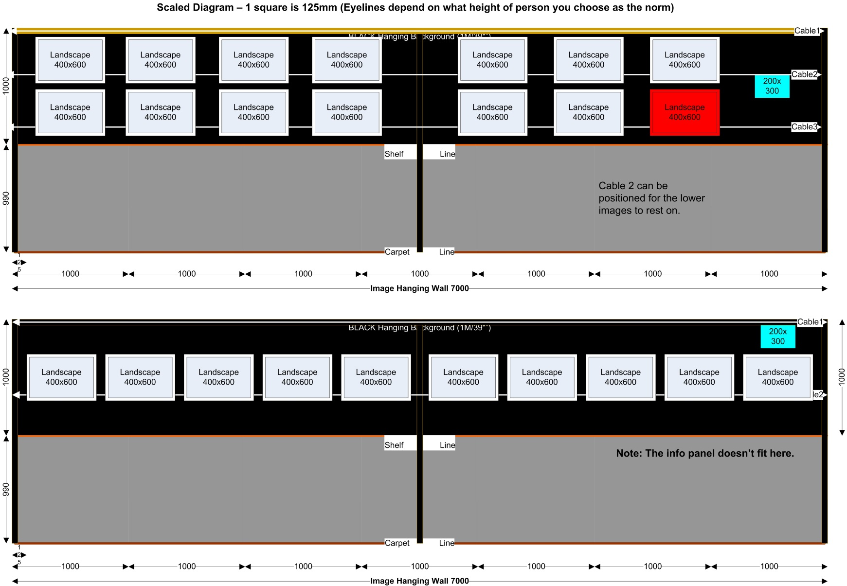
“A Gambian Experience”

Slide 6
“A Gambian Experience”
Help at the events…
Wed Evening…
welcome to guests, car park management, help with refreshments
Thur-Sat AM… (Exhibition)
welcome to public, showing people round, help with Tea & Coffee
Sat Evening… (Live Event)
Help setting up during the afternoon.
welcome to public, seating management (reservations), car park management, help with tea & coffee.

Slide 7
“A Gambian Experience”
See…
www.calnefairtrade.org.uk/age
www.cmaf.org.uk

